Slide 1
DATA ENCRYPTION
&
ZERO DOWNTIME

Slide 2
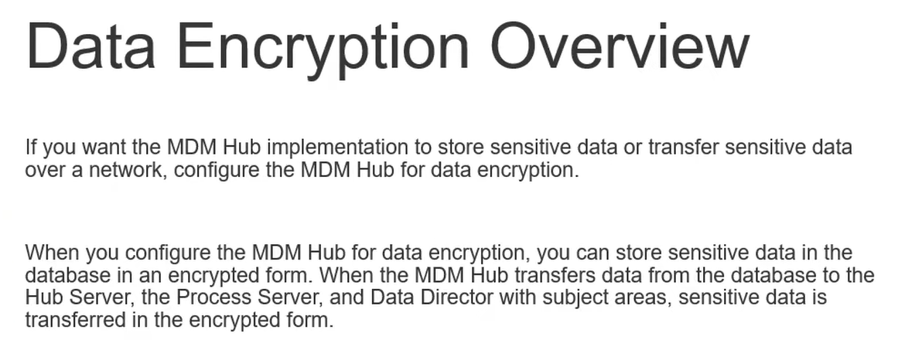

Slide 3
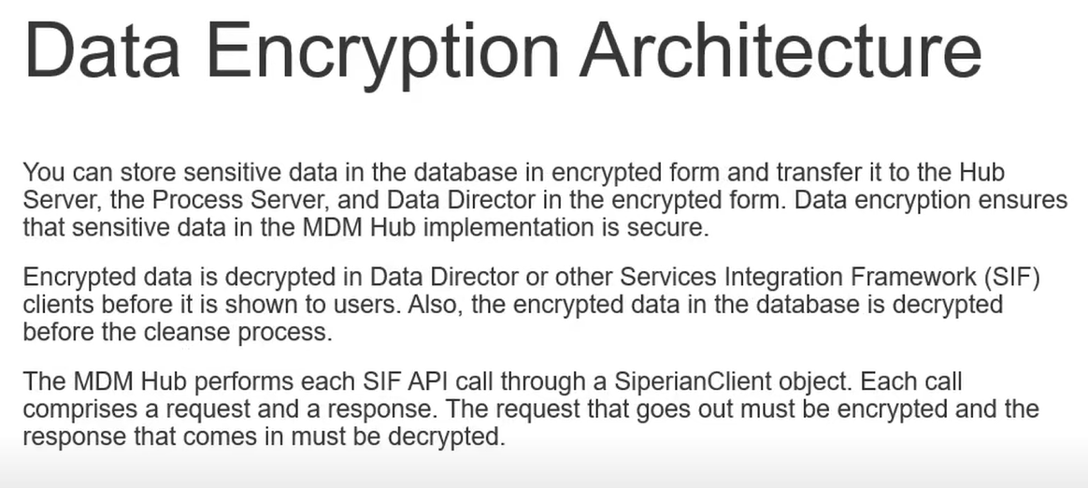

Slide 4
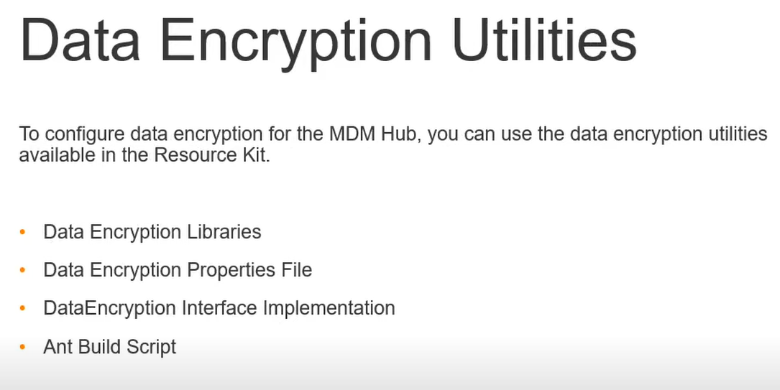

Slide 5
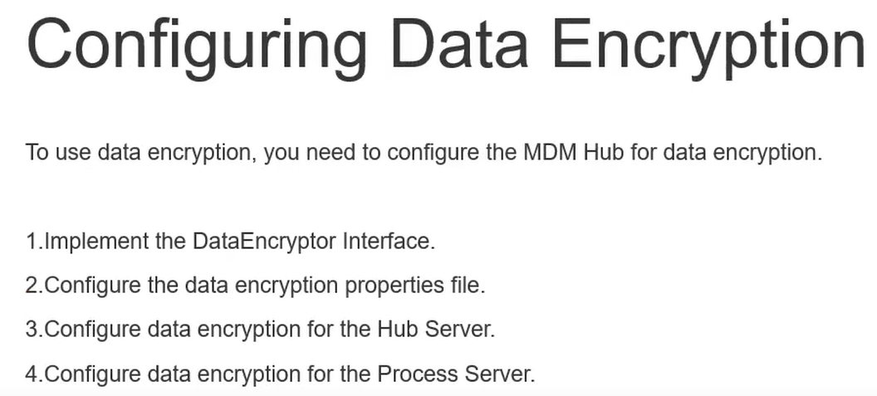

Slide 6
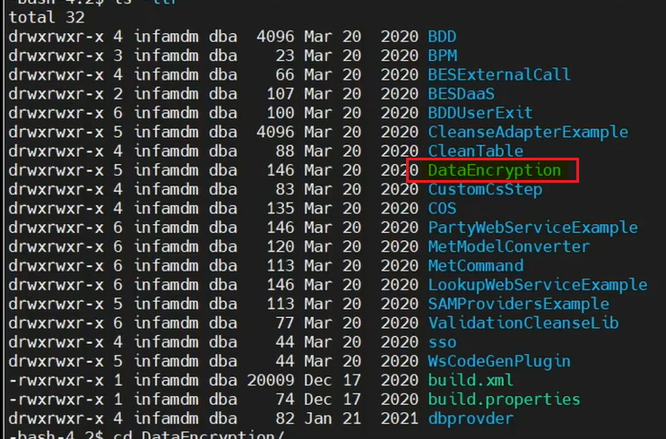
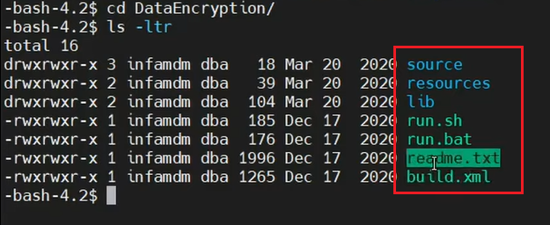

Slide 7
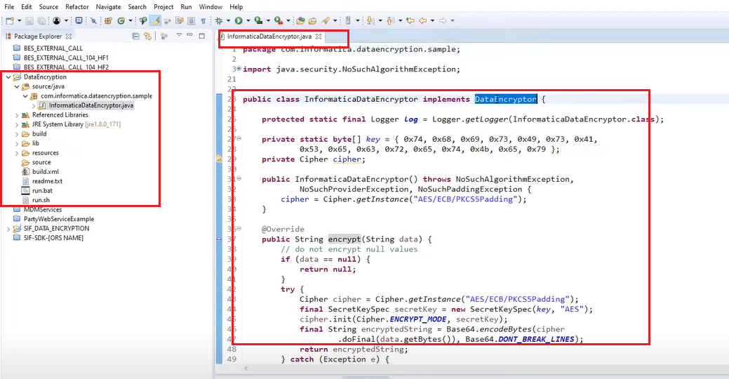

Slide 8
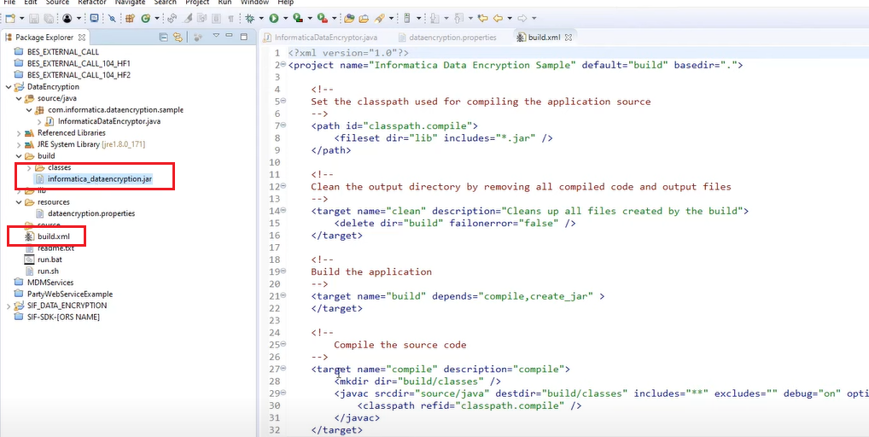

Slide 9
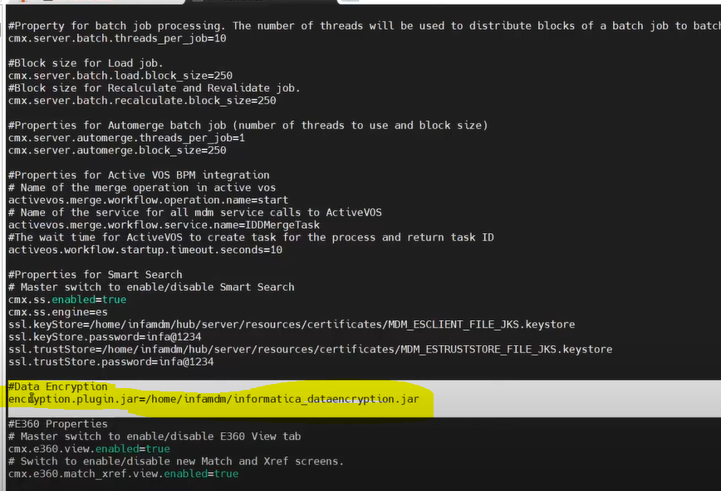
Update the JAR file path in cmxserver.properties file
Do necessary changes EJB client and other files

Slide 10
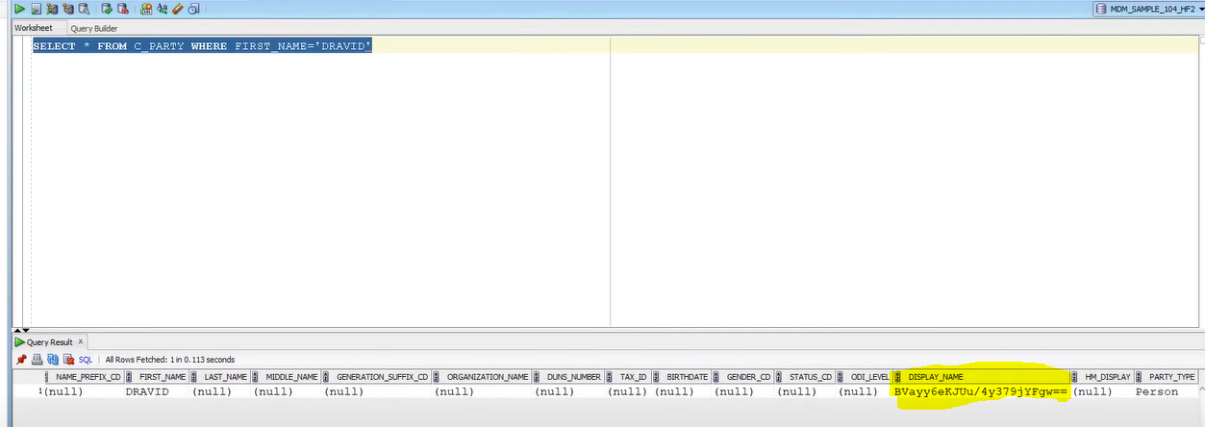
Display Name has been encrypted.

Slide 11
ZERO DOWNTIME

Slide 12
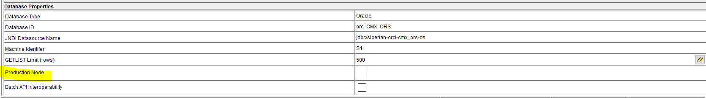
If PROD Mode is enabled then we cant do any changes in hub console and PT

Slide 13
WORKFLOW MANAGER

Slide 14
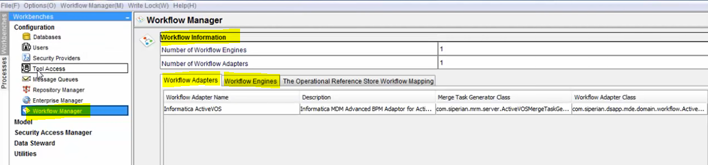
Workflow manager used to setup workflow engine.
Workflow Manager → Workflow Engine → Select ActiveVOS engine.

Slide 15
CORE MDM COMPONENT

Slide 16
Hub Console
Configuration
Model Workbench
Match & Merge
Hierarchy
Provisioning Tool
Workflow
E360

